Slide 1

DIABETES PREDICTION USING MACHINE LEARNING
Presented BY: submitted to :
Shubha Sharma mr. punit kumawat
Saurabh Kumar Sharma
Kavya Nahta

Slide 2
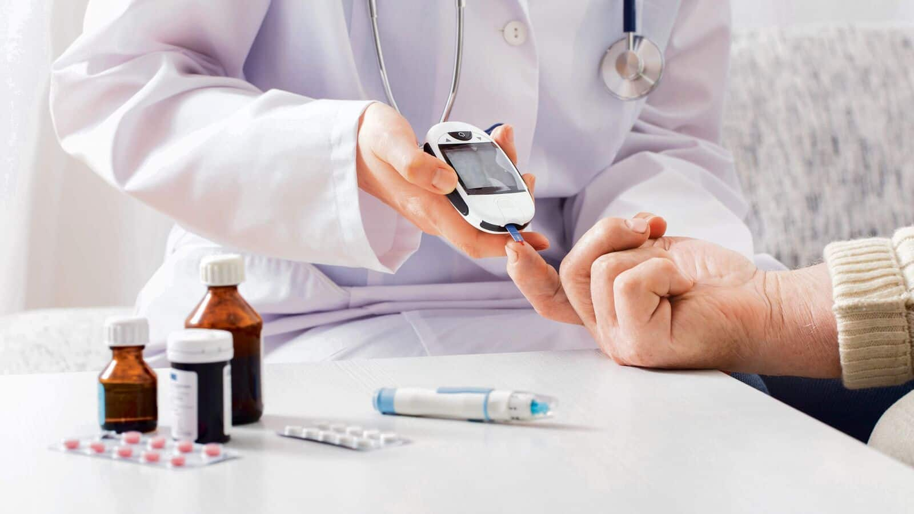
Introduction
Diabetes is a disease which is rapidly increasing all over the world. It occurs when pancreas does not produce sufficient insulin, or body can not sufficiently use insulin it produces. Diabetes person has increase blood glucose in the body. One of the major problem diabetic patients suffers from is the Diabetic Retinopathy (DR) and blindness. Since the number of diabetes patients is continuously increasing, it increases the data as well

Slide 3
Problem specification
• The most usual and conventional method for diagnosis and detection of diabetic retinopathy is by using human fundus images or retinal images.
• In our study, we focus on prediction of DR using health records of the diabetic patients.
• By using machine learning techniques, knowledge is acquired through these records, containing numerical values, to predict whether the patient is having DR or not.
• For this prediction of DR different classification algorithms (Support Vector Machine, K nearest neighbor, bagged trees, Logistic Regression) have been used.

Slide 4
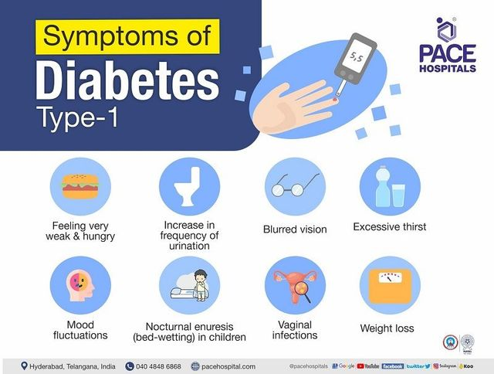
Causes for Diabetes
What causes type 1 diabetes?
• Type 1 diabetes occurs when your immune system, the body's system for fighting infection, attacks and destroys the insulin-producing beta cells of the pancreas. Scientists think type 1 diabetes is caused by genes and environmental factors, such as viruses, that might trigger the disease. Studies such as Trial Net External link are working to pinpoint causes of type 1 diabetes and possible ways to prevent or slow the disease.

Slide 5
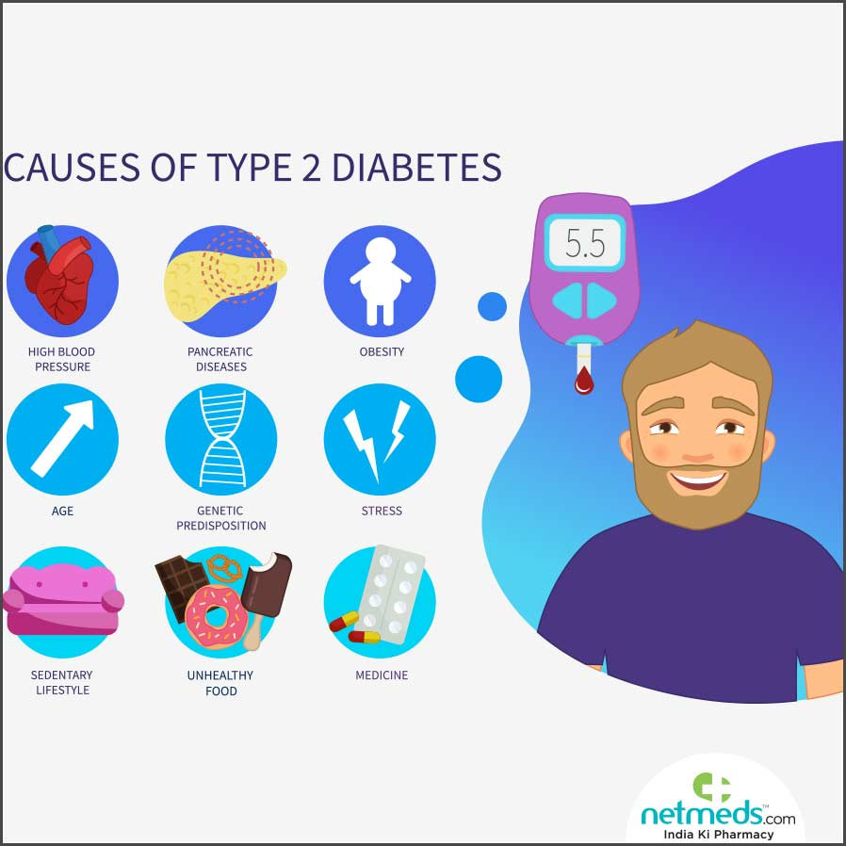
WHAT CAUSES TYPE 2 DIABETES?
Type 2 diabetes-the most common form of diabetes-is caused by several factors, including lifestyle factors and genes
Overweight, obesity, and physical inactivity
Insulin resistance
Genes and family history

Slide 6
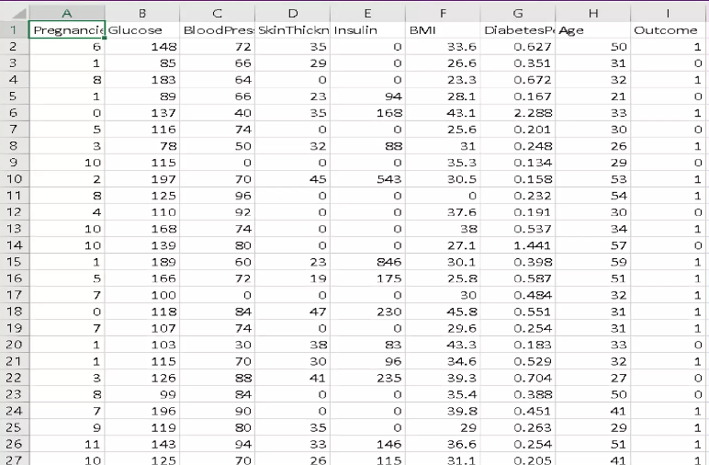
DATASET

Slide 7
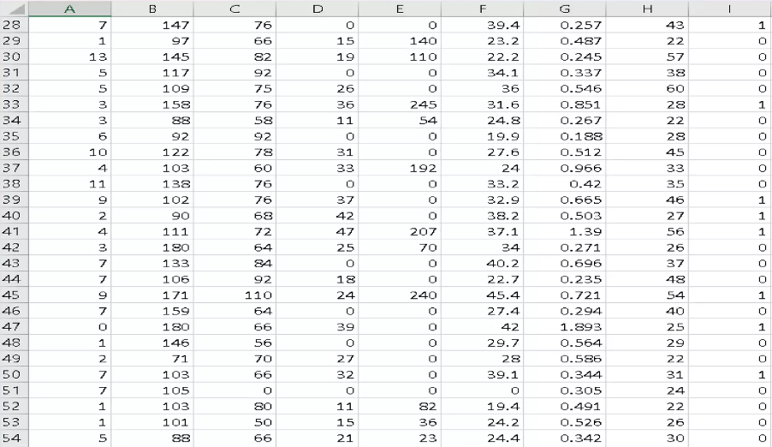

Slide 8
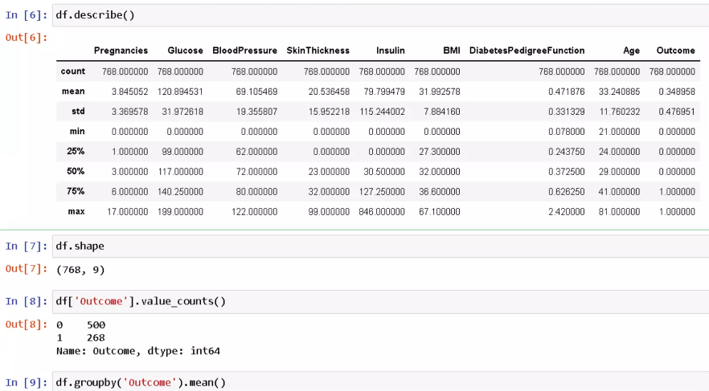
CODE AND OUTPUT

Slide 9
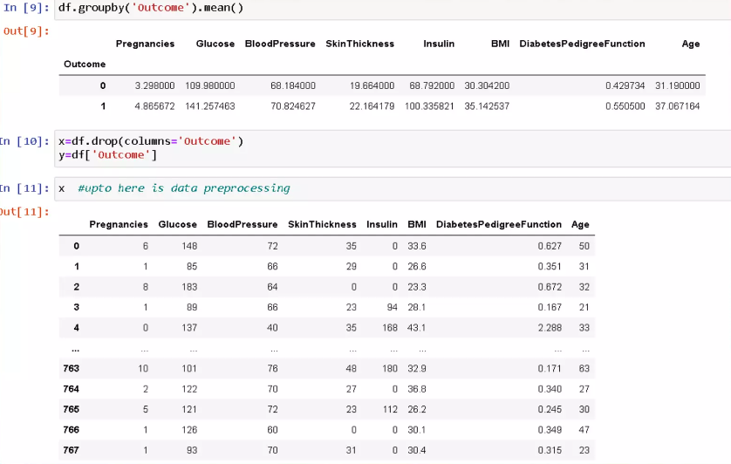

Slide 10
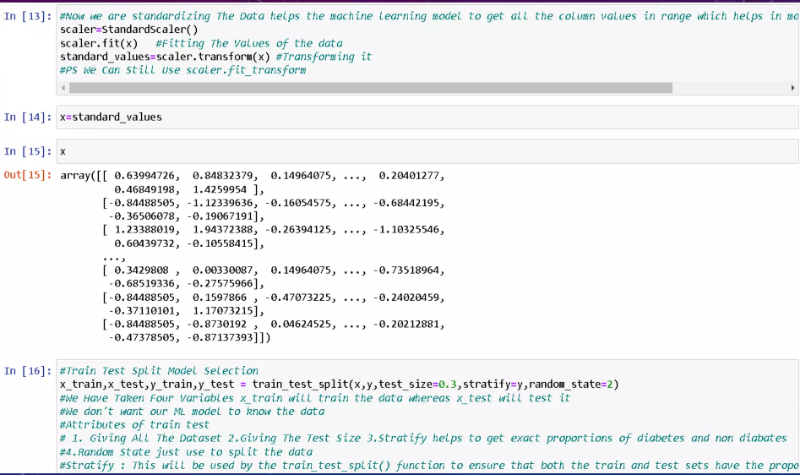

Slide 11
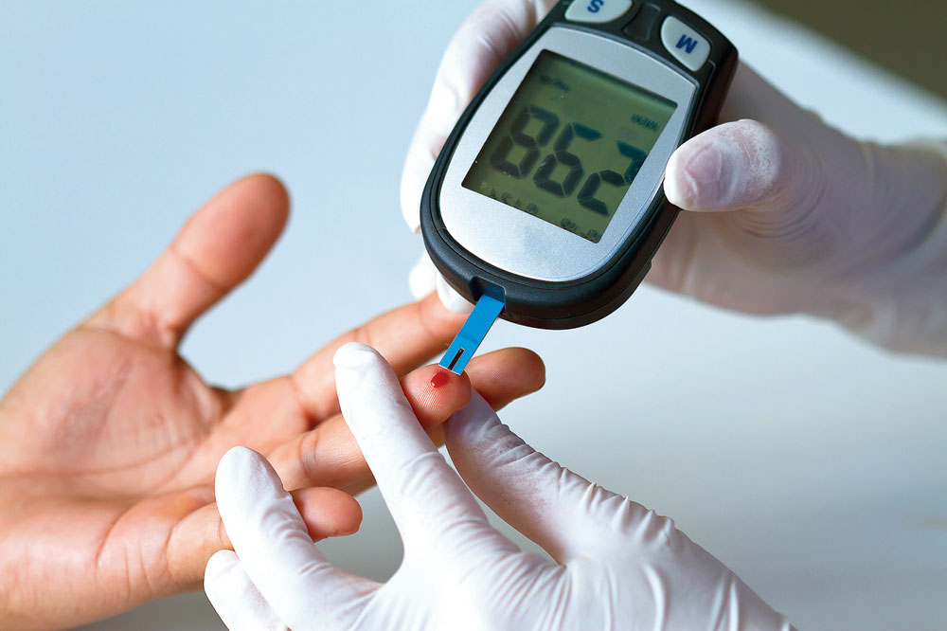
CONCLUSION
in this presentation machine learning methods are used for the prediction of Diabetic Retinopathy in patients, using their health records of diabetes.
• These health records were organized in a structured way by eliminating noisy data. With the help of machine learning algorithms, knowledge is extracted from these records in the form of numerical values for the prediction of DR.

Slide 12
THANK YOU!!

